Slide 1
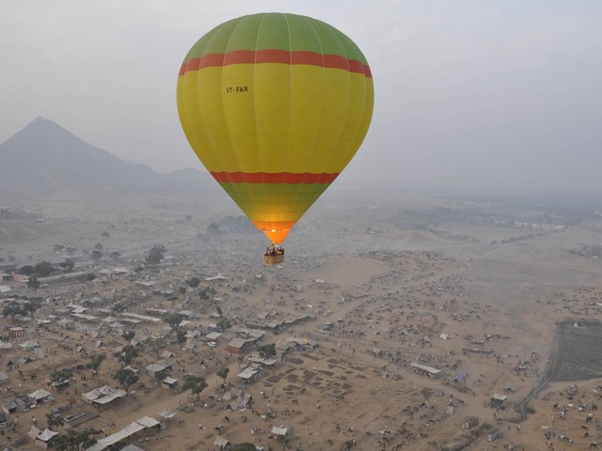
National Strategy for Adventure Tourism
Ministry of Tourism
Govt. of India
Chintan Shibir
28&29 March 2023
Prof. Sutheeshna Babu S
Nodal Officer
Central Nodal Agency for Adventure Tourism
Indian Institute of Tourism & Travel Management
Gwalior, NOIDA, Bhubaneswar, Goa, Nellore

Slide 2
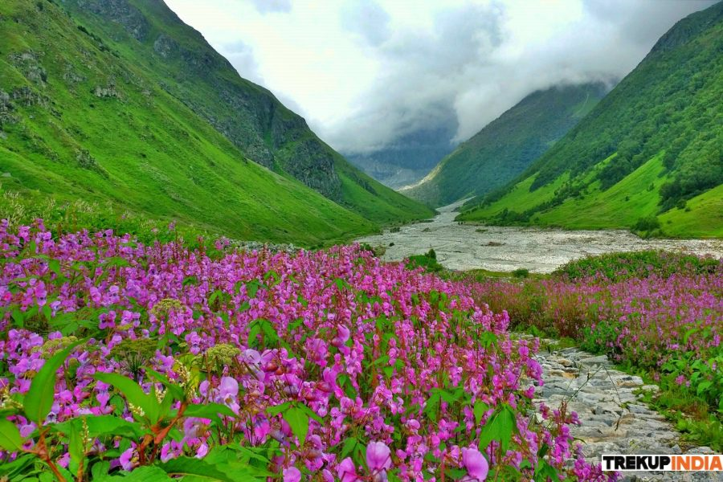
India- Adventure Tourism Advantage
Incredible physiographic & natural diversity !!
70% of the mighty Himalayas
Coastline of over 7,500 Km long
Two Inland groups rich in coral diversity
Ranks 10th in total area under forest cover
Ranks 6th in number of recognized UNESCO Natural Heritage sites
03 of the World Bio-diversity hotspots- The Himalaya, Western Ghats & Indo-Burma

Slide 3
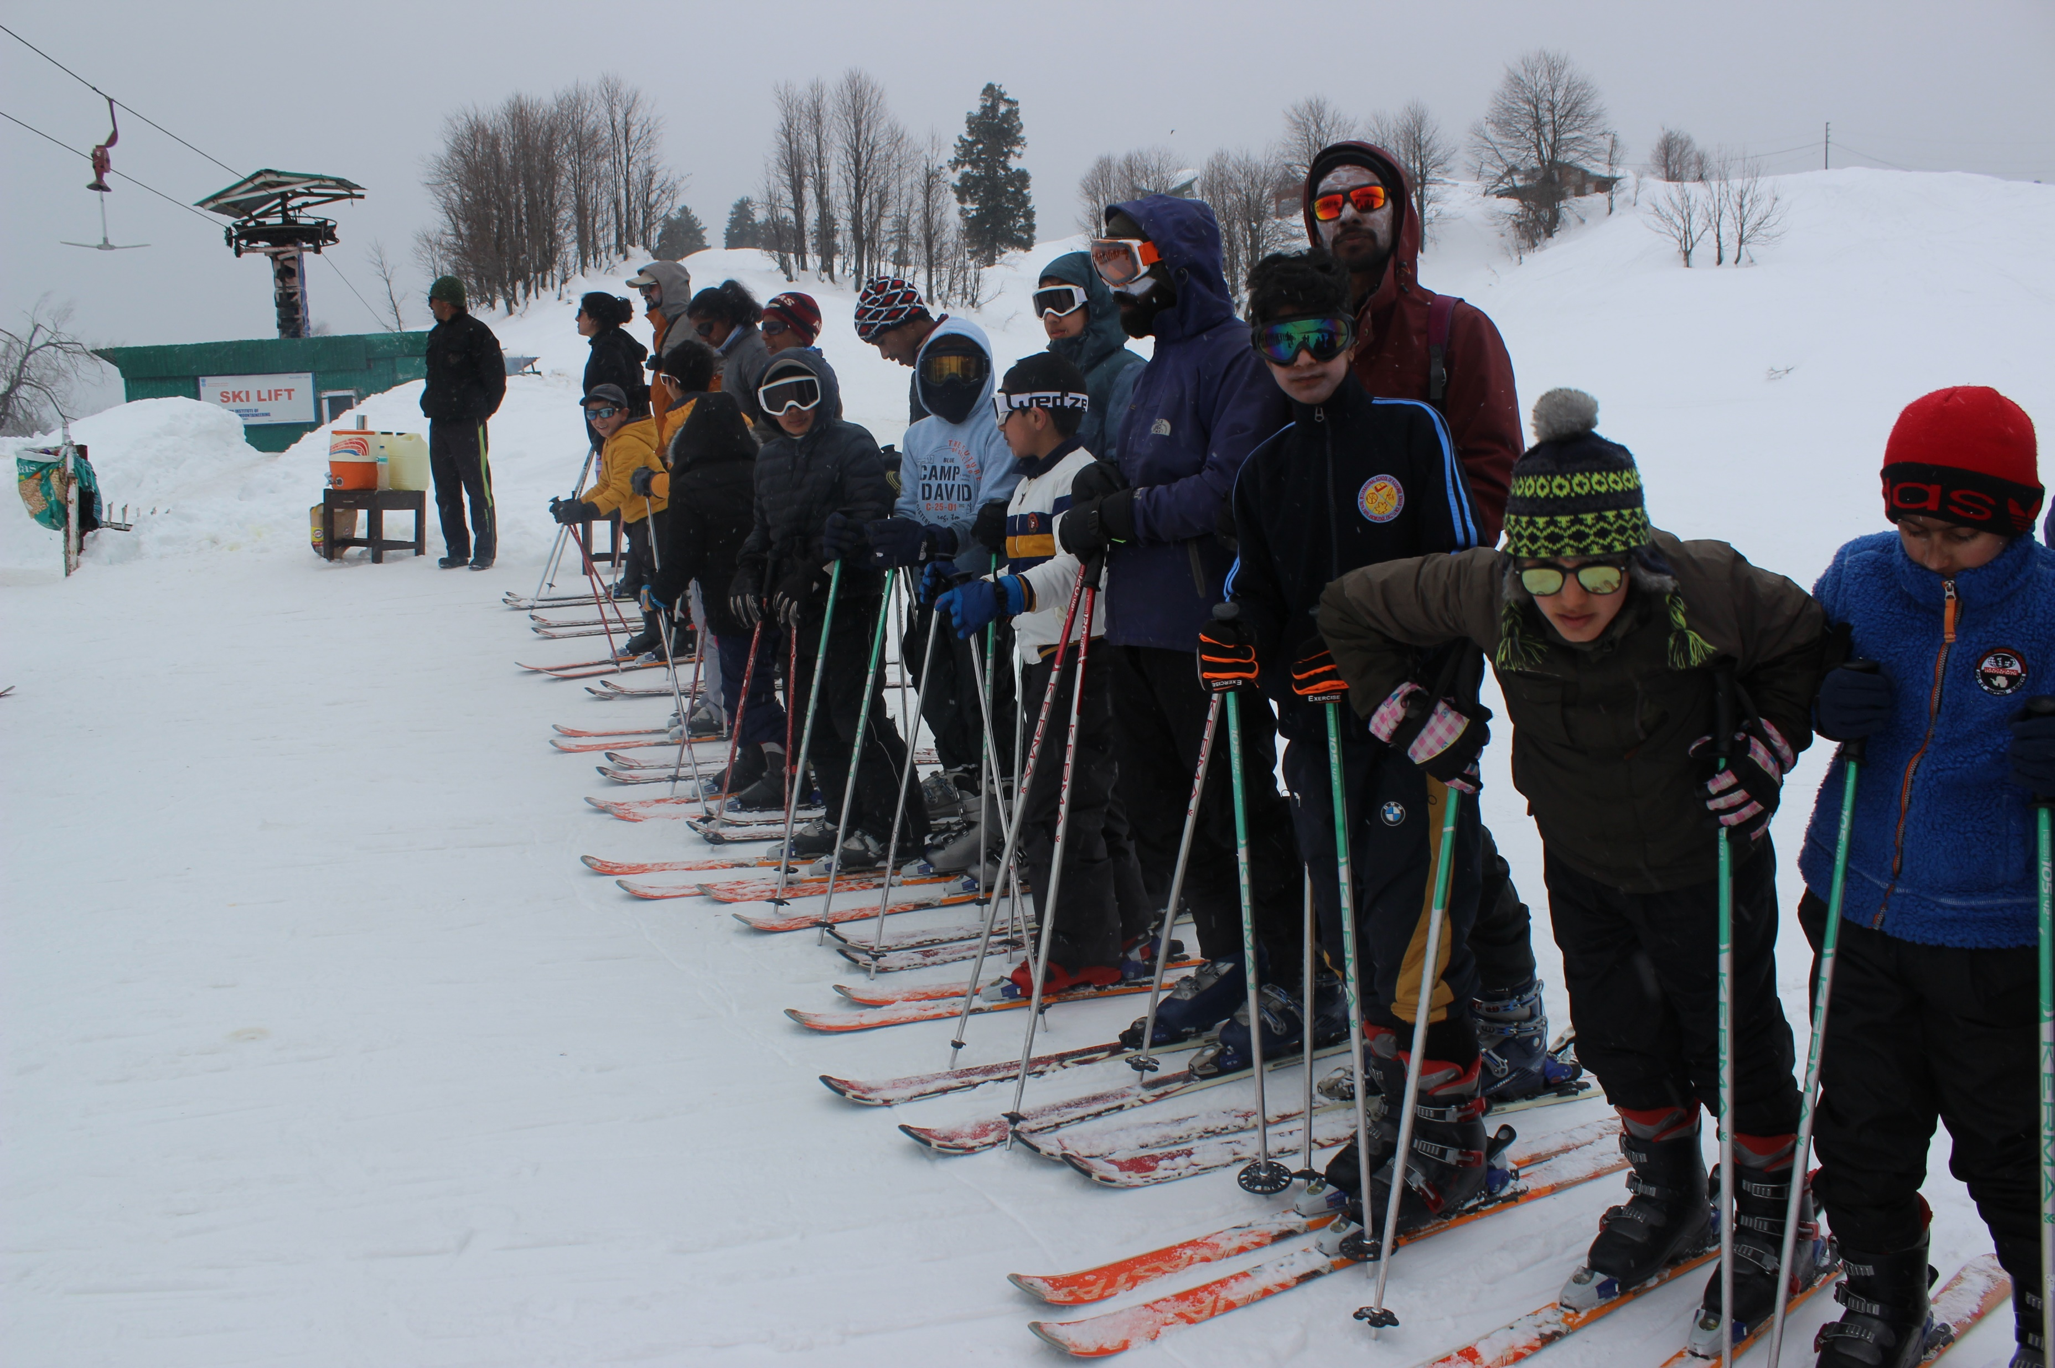
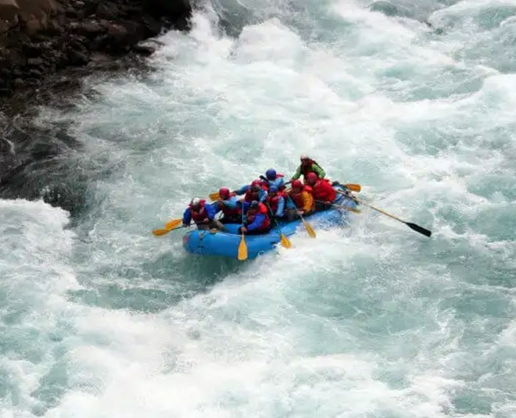
India- Adventure Tourism Advantage- Contd ….
One of the 03 countries with both hot and cold deserts
Wide array of wetlands and mangroves
Many Iconic mega-fauna species: tigers, lions, elephants, rhinos, leopards, wild buffaloes..
More than 1200 species of birds.
Climate advantage- Snow-covered peaks to sunny beaches
Immense potential for land, water and air adventure
Innumerable ‘Hard and Soft’ Adventure possibilities

Slide 4
Adventure Tourism in India- Vision and Mission
‘To position India as a preferred destination for adventure tourism globally’
Mission
‘To develop an enabling ecosystem for the growth of Adventure Tourism in India and create synergies amongst Central Government, State Governments, Private Sector and local communities, for the development of Adventure Tourism’
Vision
Adventure Tourism Definition:
A type of Niche Tourism where Exploration or Travel Involves some degree of risk (real or perceived), may require special skills and physical effort.

Slide 5
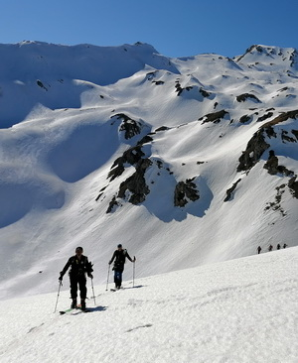
Adventure Tourism - Guiding Principles
3.1. Guiding Principles for Adventure Tourism
Develop adventure tourism in with local community as partners
Mapping adventure markets and trends, product development and encourage public-private partnership.
Adherence to safety standards; Strict compliance and enforcement of regulations on safety and service standards.
Prioritize and develop the type of infrastructure valued by adventure tourists
Accessibility; Seamless access to information; Strategise to benefit from sharing real-time experiences by Tourists.
Price competitiveness; Accurate and innovative marketing.
Notes:
Source: https://www.gujarattourism.com/north-zone/sabarkantha/polo-forest.html

Slide 6
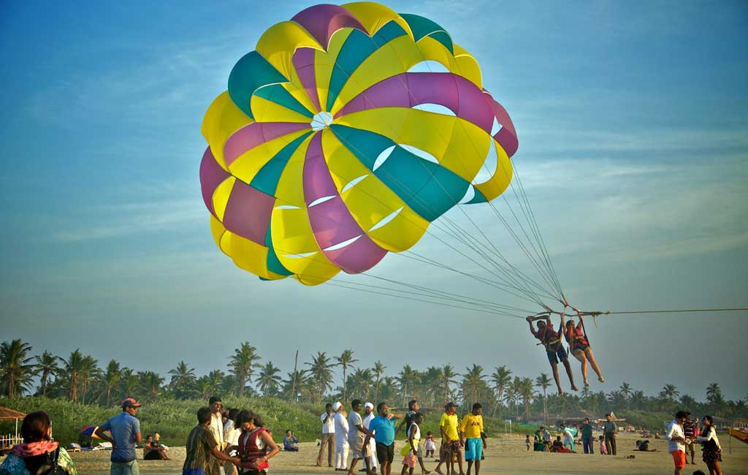
Adventure Tourism- Strategy Pillars
State Assessment, Ranking and Strategy
Skills, Capacity Building and Certification
Marketing and Promotion
Strengthening adventure tourism safety management framework
National and State Level Rescue and Communication Grid
Destination and Product Development
Governance and Institutional Framework
Notes:
Source: http://enviscpreec.blogspot.com/2014/06/sacred-groves-of-meghalaya.html

Slide 7
Strategy Pillar: State Assessment, Ranking and Strategy
3. State Assessment, Ranking & Strategy
Increase competitiveness and encourage states to actively develop and promote Adventure Tourism.
Capacity Building exercise to encourage mutual learning and to provide support in policy formulation and implementation
Ranking and Classification of states into Leaders, Aspiring Leaders and Emerging States
Training and support to officials and stakeholders for ranking exercise.
Improving India’s World Ranking in Adventure Tourism
Training and support to officials and stakeholders for ranking exercise
Assistance to the States in preparing Strategies
Notes:
Source: https://www.gujarattourism.com/north-zone/sabarkantha/polo-forest.html

Slide 8
Strategy Pillar: Stakeholders
2.2
Central Ministries
State Governments
Panchayati Raj Institutions
Non Government Organisations
Local Community
Industry & Training Institutions
Tourists
Notes:
Source: https://www.meghalayatourism.in/destinations/

Slide 9
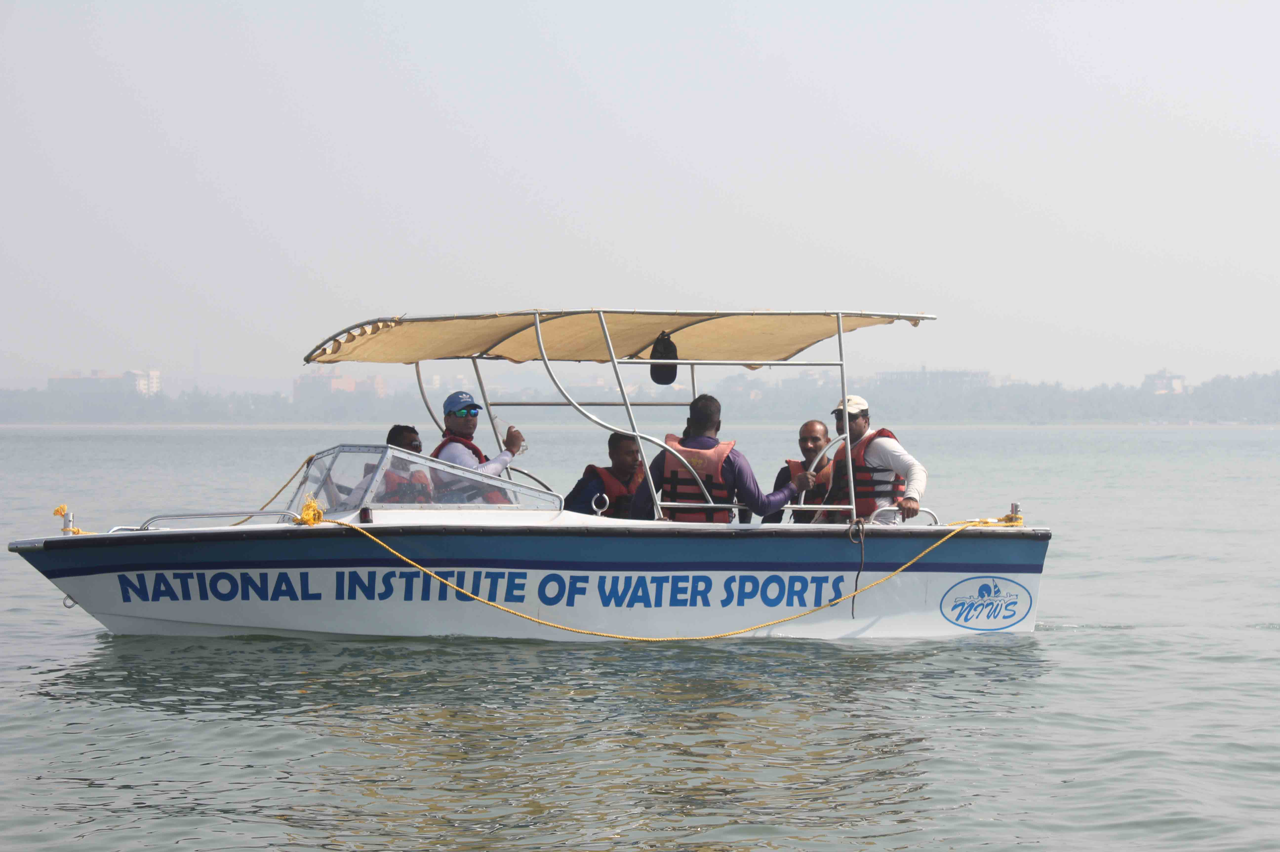
Strategy Pillar: Skills, Capacity Building and Certification
4.
4.1. Skill Development of Adventure Activity Service Providers
4.2. Skill Training and Capacity Building of Local Communities
4.3. Training and Certification of Adventure Tour Guides
4.4. National and State Resource Centres
4.5. Certification for Adventure Activity Service Providers
Notes:
Source: https://ttravelog.com/articles/true-beauty-of-maredumilli-travel-guide_DkR.html

Slide 10
Strategy Pillar: Marketing and Promotions
5.
5.1. Creating a Sub Brand
5.2. Dedicated Promotional Campaign
5.3. Step Specific Campaigns
5.4. Destination Specific Campaigns
5.5. Campaigns for Responsible Travellers

Slide 11
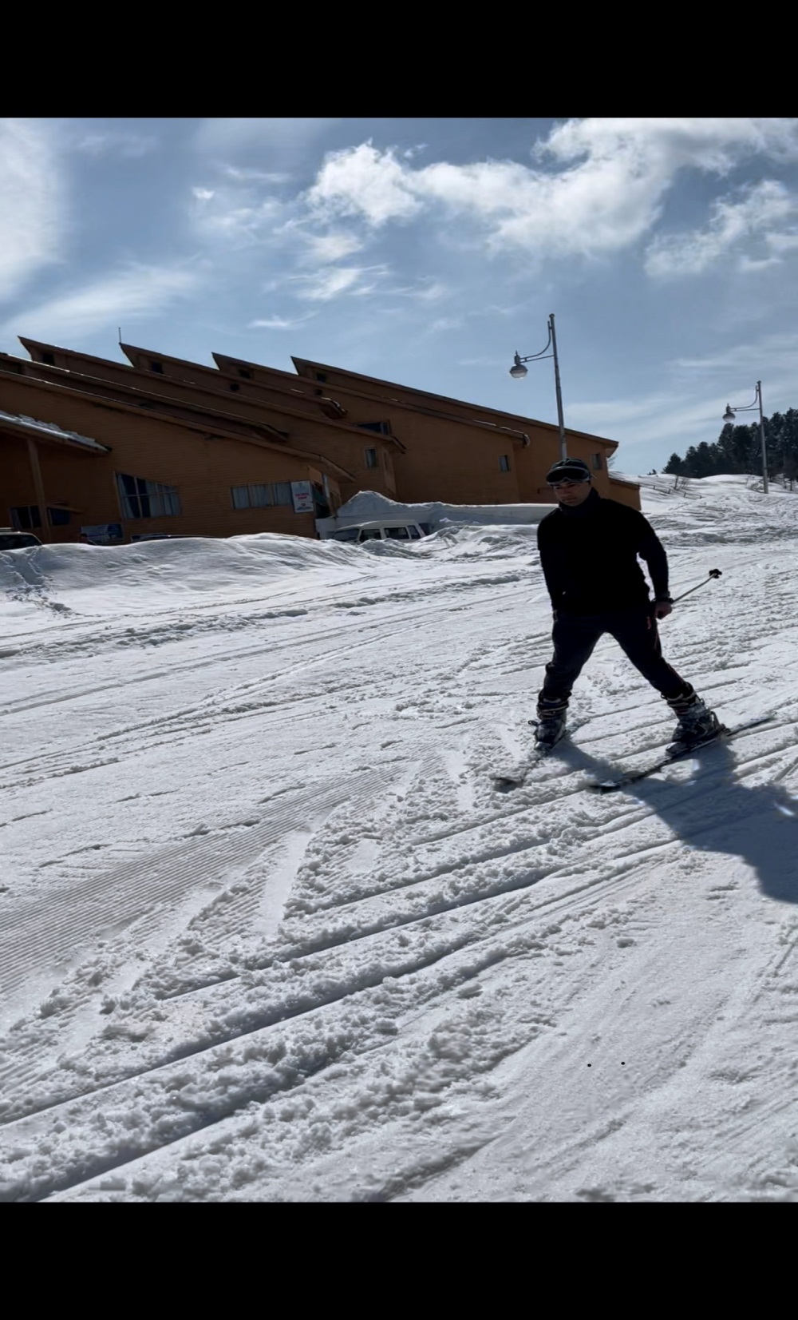
Strategy Pillar: National Adventure Tourism
Safety Management Framework
6.
6.1. Adventure Tourism Safety
6.2. Current Efforts for Adventure Tourism Safety
6.2.1 Advisory regarding Guidelines frames by ADTOI
6.2.2. State level measures for Adventure Safety
6.2.3. Safety Management Standards
6.3. National Adventure Tourism Safety Management Framework
6.4. Key Objectives of Safety Framework
6.5. Guiding Principles for Safety Framework
6.6. Strategic Elements of Safety Framework
Notes:
Source: https://www.thetravel.com/abode-of-clouds-india-guide-what-to-do/

Slide 12
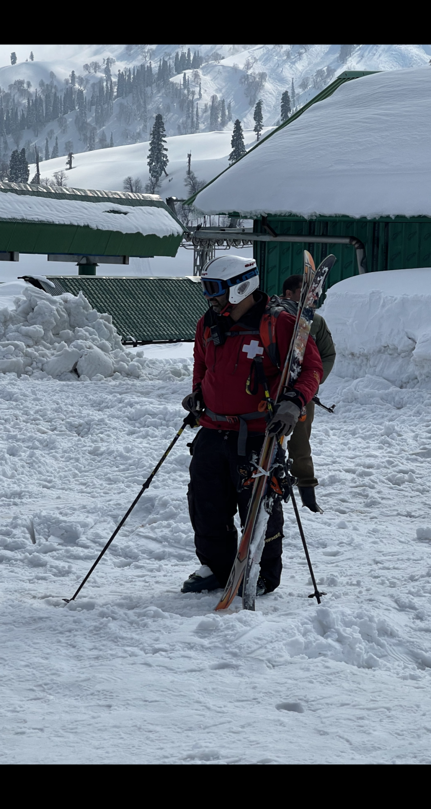
Strategy Pillar:
National/ State Level Rescue and Communication Grid
7.
Introduction:
Aim of Sustainable Tourism
7.1. Immediate Evacuation and Rescue to save Casualty
7.2. Dedicated rescue teams covering each adventure site-: An adventure institute/Defence or Paramilitary forces/NDRF/SDRF
7.3. Functions of Rescue and Communication Grid
i) Immediate rescue and evacuation of stranded adventure tourists
ii) Guiding agencies in tackling incidents & accidents.
iii) To live maps of all the adventure sites with latitudes and longitudes.
iv) Updated Weather Reports
v) National Level helpline number
vi) Allow limited use of Satellite phones & Drones for safety of Tourists.
Notes:
Source: https://www.gyaktoursandtravels.com/zanskar.html

Slide 13
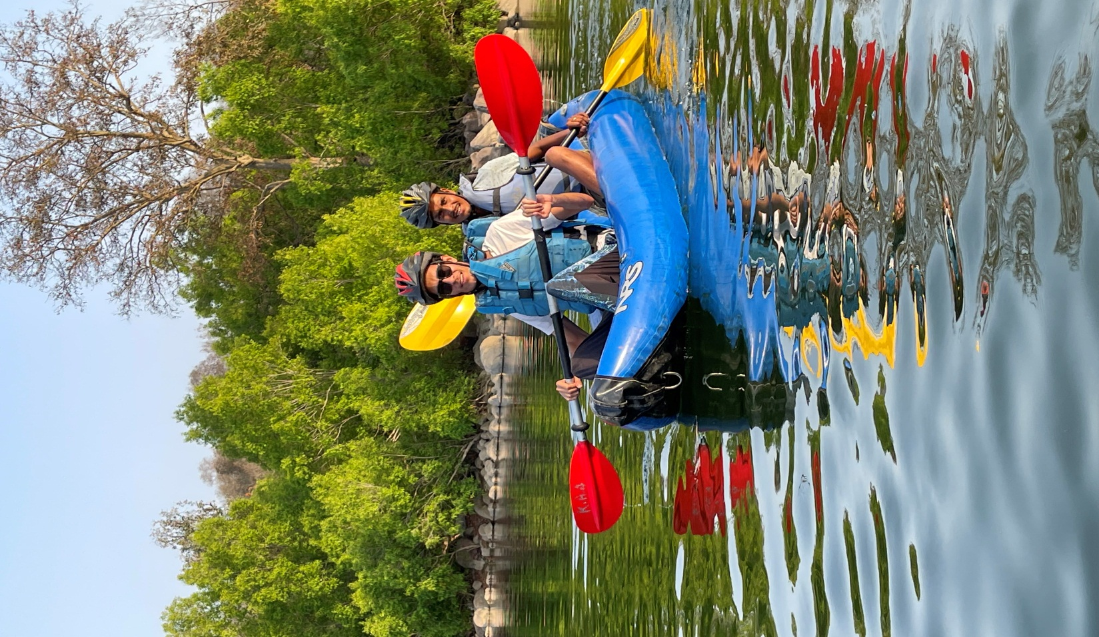
Strategy Pillar: Destination and Product Development
8.
8.1. Identification of Destinations, Profiling and Prioritization
8.1.1. The States to identify and profile adventure destinations by offerings- Land, Air, Water- for Soft, Hard adventures.
8.1.2. The States to prioritize development of identified destinations destinations based on the existing connectivity and tourist circuits, current tourism ecosystem, unique tourism offerings and future potential.
8.2. Development of Prioritised destinations.
8.3. Implementation of Development Plans.
8.4. Private Sector Partnership in adventure Tourism.
8.5. Homestay and Community Lodges
Notes:
Source: https://globalgrasshopper.com/destinations/asia/unspoilt-places-to-visit-in-india-for-travel-snobs/

Slide 14
Strategy Pillar: Governance and Institutional Framework
Union Minister of Tourism
Provide overall vision and guidance for the development of Sustainable Tourism in country
Vision Group on Adventure Tourism
Cabinet Secretary
Review and resolve inter-Ministerial issues and provide guidance for greater convergence of Central Schemes
Inter-Ministerial Coordination Committee
Secretary (Tourism)
Guide the operationalization and implementation of various strategic initiatives to strengthen the sustainable tourism ecosystem
National Board of Adventure Tourism
Central Nodal Agency
Support & Assistance for coordinating and evolving strategy, actionable plans and schemes
Chief Secretary (State / UT)
Coordinate, review and resolve issues regarding implementation of strategy and other State specific issues
State Steering Committee
District Collector
District Level Committee
Coordinate and review progress & provide impetus to the development of sustainable and responsible tourism
Notes:
Pyramid structure to be inserted to better demonstrate the governance framework

Slide 15
Strategy Pillar: Governance and Institutional Framework …..
9.
9.1. Formulate Action Plan in consultation with Stakeholders
9.2: National Board on Adventure Tourism
i) Certification Schemes
ii) Safety Guidelines
iii) Capacity Building
iv) Marketing and Promotion
v) Destination and Product Development
vi) Private Sector Participation
vii) Specific Strategies
viii) Any Other Measure for Growth of Adventure Tourism
Notes:
Source: https://www.dealsshutter.com/blog/places-to-visit-in-maharashtra/

Slide 16
Way Forward
Formulating a detailed Action Plan for implementation of Strategy.
Identifying national and global best practices and preparing tool kits for their replication by the States
Benchmarking State policies and standards and preparing model policies and standards
Capacity Building measures including setting up Resource Centres and Centres of Excellence
Facilitating the adoption of digital technologies for Adventure Tourism
Formulation of a dedicated scheme to support the development of Adventure tourism in the Country
Notes:
Source: https://www.greavesindia.co.uk/the-essence-of-rajasthan-2/

Slide 17
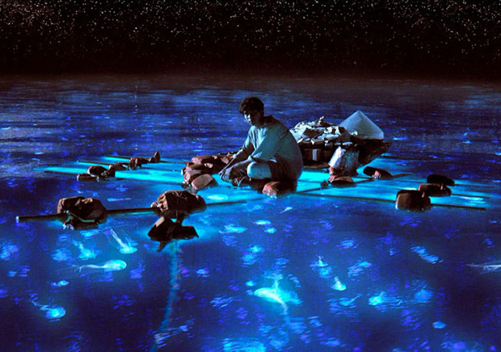
Proposed Model Adventure Tourism Law Framework
3.1. Guiding Principles for Adventure Tourism
CAN-AT prepared a Draft framework and under consultation process
1. Coverage:
Adventure Activity Service Provider
Certified Operator
Adventure Tour Operator
Adventure Guide
2. Institutional Framework:
Adventure Tourism Safety Division in State Govts.
Safety Audit & Physical Inspection
Adventure Tourism Area
Notes:
Source: https://www.gujarattourism.com/north-zone/sabarkantha/polo-forest.html

Slide 18
Proposed Model Adventure Tourism Law Framework
3.1. Guiding Principles for Adventure Tourism
3. Registration of Operators & Service Providers:
Process of registration
Issuance of Certificate of Registration
4.a: Refusal of Registration
4.b: Appeal
5. Obligation (Operators & Service Providers)
6: Penalties
7. Insurance
Notes:
Source: https://www.gujarattourism.com/north-zone/sabarkantha/polo-forest.html

Slide 19
Proposed Adventure Tourism Rescue Center (ATRC) Framework
3.1. Guiding Principles for Adventure Tourism
CAN-AT prepared a Draft framework and under consultation process
Aim:
To function as quick response mechanism during the emergencies and assist the tourists in distress or imminent danger and reduce fatality during an emergency/accident, eventually contributing towards enhancement of tourist safety and Adventure Destination image
2. Roles:
To act as a Focal Point
Remain in full in readiness till the conclusion of each Adventure activity Adventure Tourism Area
Liaison and Coordinate with various bodies
Obtain details of Adventure Operators
Record and maintain round the clock communication
Coordinate and involve local community
Maintaining daily weather report
Notes:
Source: https://www.gujarattourism.com/north-zone/sabarkantha/polo-forest.html

Slide 20
Proposed (ATRC) Framework …..
3.1. Guiding Principles for Adventure Tourism
3. Manning of ATRC:
ARTC Head: District Tourist Officer or District Disaster Management Officer
Minimum Staff strength: 08 trained personnel
Liaison and Coordination
Qualification of the Personnel
4. ARTC Infrastructure:
Control Room with wireless communication system:
Stowing facility for rescue gears and equipment;
Changing Room and Wash Room for Rescue Centre Staff;
Rescue Equipment Storage Room with adequate ventilation;
Power Backup system for 24x7 power supply
Repair and maintenance
Rescue Vehicle with following specification:
Notes:
Source: https://www.gujarattourism.com/north-zone/sabarkantha/polo-forest.html

Slide 21
Proposed (ATRC) Framework …..
3.1. Guiding Principles for Adventure Tourism
5. Equipment for ATRC:
Wilderness/ Mountain/ Gorge Search & Rescue Equipment
Swift Water/ Open Water Search & Rescue Equipment
6. ATRC- Emergency Response Procedure
7. Establishment of ATRC:
Central Govt. to support establishment of the Center
State/UT Govt. to Manage and run the Center
Notes:
Source: https://www.gujarattourism.com/north-zone/sabarkantha/polo-forest.html

Slide 22
THANK YOU

